Slide 1

Image Captioning
With Audio Generation
Image Speaks a Thousand Words
Team 6
Bhakti Jayesh Raichura
Khushee Subash Thakker
Shreya Srirama
Varsha Srinivasan

Slide 2

What do you see in this Image?

Slide 3
It’s the same for a Blind Person

Slide 4

Motivation
Vision deficiency, also known as loss of vision or vision impairment, is nothing but a vision disability which has no immediate remedies of any kind. It is something that any person does not wish to have.
Over 2.2 billion people suffer from blindness and visual impairment worldwide.
Leveraging Deep Learning models for Image Captioning to add Audio
Notes:
– Vision deficiency, also known as loss of vision or vision impairment, is nothing but a vision disability which has no immediate remedies of any kind. It is something that any person does not wish to have. Millions of individuals are visually impaired globally, according to the World Health Organization(WHO).Without one of the most useful sensory organs in a technologically developed environment where even the smallest piece of work needs hearing, it is very hard to survive. In today’s world where the technology sector is growing, many developments can be made where the technology can provide aid to the visually impaired people. One technique is to detect items in an image and have a meaningful caption that will be in the form of audio that would enable visually disabled people to associate all object to an image.
– Generating Image Captions using deep learning has produced remarkable results in recent years. We wanted to explore more with image captioning and provide a novelty of adding audio to the captions

Slide 5
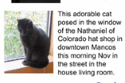

Applications
1
4
Aid to Blind People
Ecommerce, Photo-Sharing Services And Google Image Search
2
Better User Experience Understanding Complex Art Images
5
Image Captioning For Social Media
3
6
CCTV Camera
Self Driving Cars
Notes:
CCTV : CCTV camera are everywhere today but along with just viewing the world what if we generate meaningful captions then we can raise alarms as soon as there is some malicious activity going on somewhere. This would reduce some crime or accidents.
Google search: Every image could be converted to text and search can be performed based on caption
Self drive: Automatic driving cars are biggest challenges and if we can properly caption the scene around the car it can give boost to self driving system
Aid to Blind people: guide with on roads without support . FIrst scene into text and then text into voice
E commerce: At the same time, image captioning can be implemented by a photo-sharing service or any online catalog to create an automatic meaningful description of the picture for SEO or categorizing purposes. Moreover, captions allow checking whether the image suits the platform’s rules where it is going to be published. Here it serves as an alternative to CNN categorization and helps to increase traffic and revenue.

Slide 6
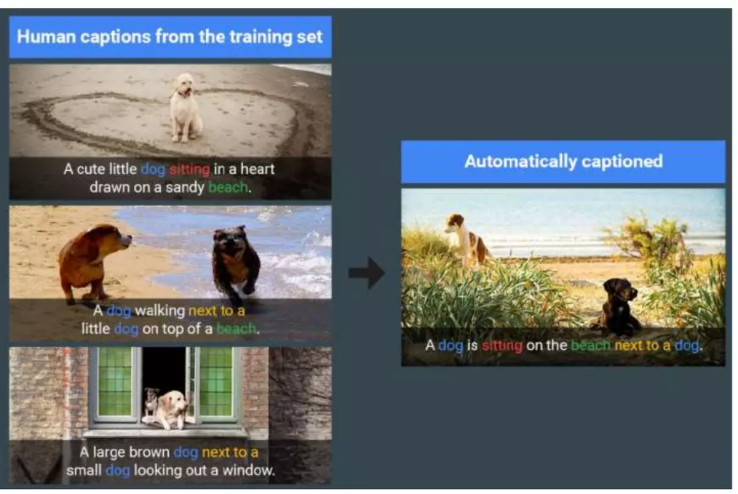
Objective
Can computer program take an image and give a relevant caption?
Develop a DL Model to Describe Images
Image Captioning
Audio Generation for Captions
Recognize object in Image
Generate a fluent caption in natural language
Notes:
Image captioning can be regarded as an end-to-end Sequence to Sequence problem, as it converts images, which is regarded as a sequence of pixels to a sequence of words. For this purpose, we need to process both the language or statements and the images. For the Language part, we use recurrent Neural Networks and for the Image part, we use Convolutional Neural Networks to obtain the feature vectors respectively.

Slide 7
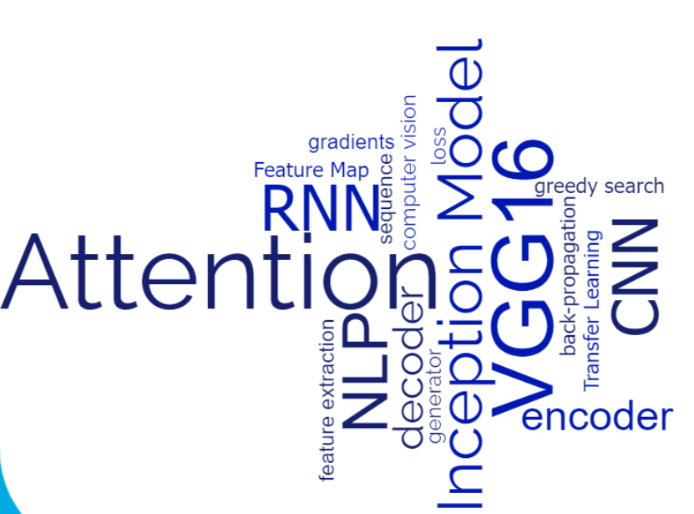
Background
Notes:
https://www.analyticsvidhya.com/blog/2021/12/step-by-step-guide-to-build-image-caption-generator-using-deep-learning/

Slide 8
Literature Survey
2019
2019
2020
2020
2022
Dang et al. VGG 16 and InceptionV3 for Feature Extraction and LSTM for Language Model
ACM
Flickr 8k
B@1 0.51 B@2 0.31
Pan et al. unified attention block called X-Linear attention block
CVF
MS COCO Karpathy test split
B@1 0.78 B@2 0.62
Cornia et al. Meshed memory Transformer
CVF
MS COCO Karpathy test split
B@1 0.81 B@2 0.66
Huang et al. Attention on Attention network both on encoder and decoder
CVF
MS COCO Karpathy test split
B@1 0.85 B@2 0.65
Kumar et al. a dual-modal transformer to capture the model interactions within an attention block
MDPI
Flickr 8k
B@1 0.70 B@2 0.64
Author and Proposed Methodology
Publication
Dataset
Bleu 1 Bleu 2

Slide 9
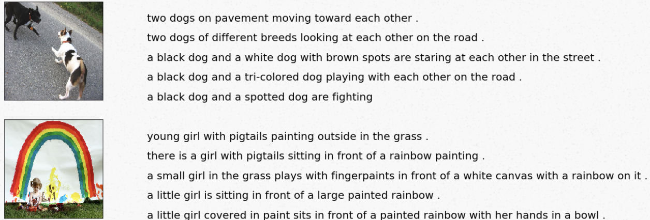
About the Dataset
Dataset Used: Flick8K
It consists of 8,091 images, each of which is paired with five different captions, for a total of 40K captions
The images in the dataset are of varying sizes and aspect ratios
Dataset split into training, and testing with 6K and 2K images respectively

Slide 10
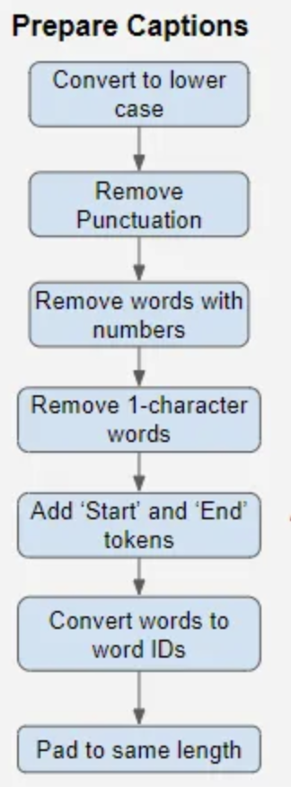
Data Preprocessing and caption preparation
Vocab: 8918
Images are Resize, augmented & Normalization (required for InceptionV3)
We download this pre-trained model, truncate the Classifier section and encode the training images.
For captions, converted all words to lowercase and removed punctuation, words with numbers and short words with a single character.
Tokenization and length extension by appending padding tokens
Padding can result in a risk of adding penalty to the model. Hence we use masking. Loss = Loss * Mask
Vocab: 8357

Slide 11

Deep Learning Models
Encoder
Decoder
VGG 16
LSTM
1
2
Image Feature Extractors
Caption Generators
Models
Two Models
Encoder
Decoder
Inception V3
RNN + Attention

Slide 12
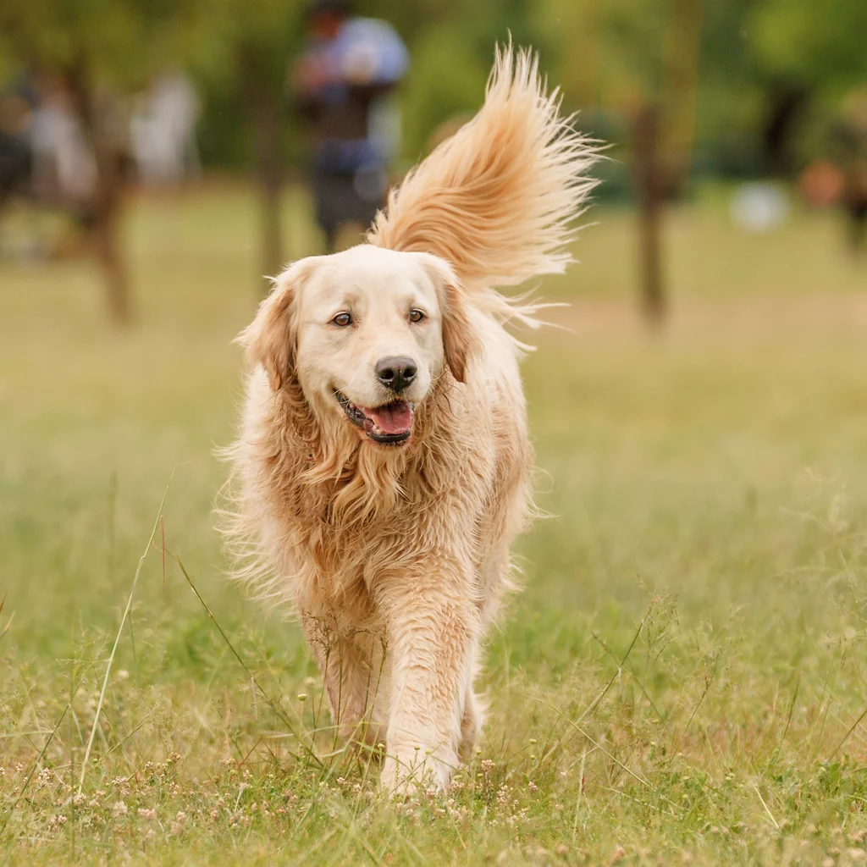
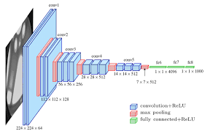
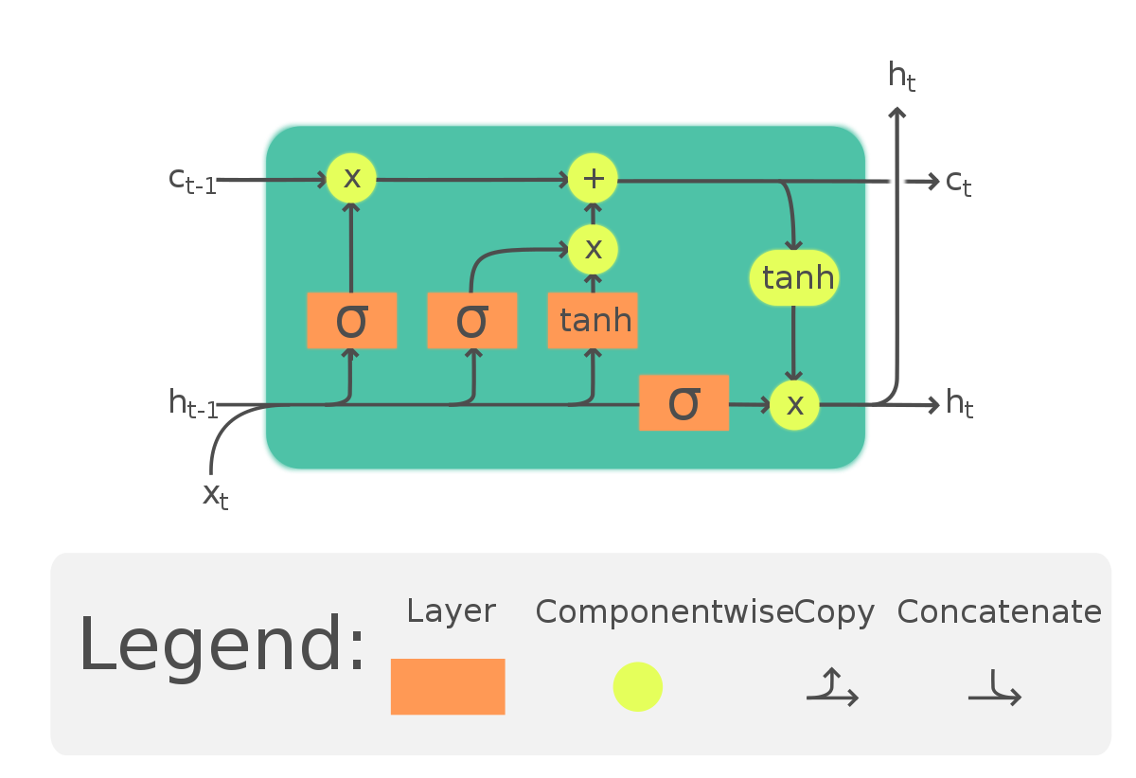

Baseline Model
Pretrained VGG 16
Input image given to
Feature Vector
Output Caption
A dog walking on the green grass
Text-to-Speech
Caption Generation
LSTM Network
Notes:
Image Input: We start with an input image, which could be any picture you want to generate a caption for. Let's say it's a picture of a cat.
VGG16 (Convolutional Neural Network): The image is passed through a pre-trained VGG16 model. Think of this model as a "visual brain" that can recognize and understand different visual features in the image, such as shapes, colors, and textures. The VGG16 model has been trained on a large dataset and has learned to extract meaningful information from images.
Feature Extraction: The VGG16 model extracts relevant features from the image. It identifies key visual elements like the cat's ears, eyes, and body shape. These features are represented as a set of numbers that describe the image's visual content.
LSTM (Long Short-Term Memory): The extracted features from the image are then passed into an LSTM network. You can think of the LSTM as the "language brain" that understands and generates meaningful sentences. The LSTM is trained on a large dataset of image-caption pairs, where it learns the relationship between the visual features of an image and the corresponding captions.
Caption Generation: The LSTM takes the visual features and processes them sequentially. It generates a series of words, one at a time, to form a caption. At each step, the LSTM predicts the next word based on its understanding of the visual features and the context of the previously generated words. It continues this process until it generates a complete caption.
Output: The final output is a caption that describes the image. In our example, it might be something like "A cute cat sitting on a window sill."

Slide 13
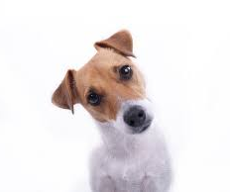
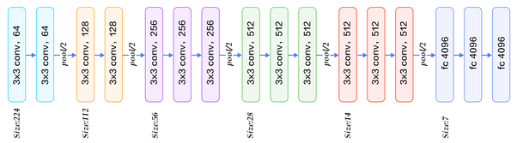
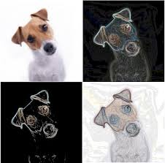
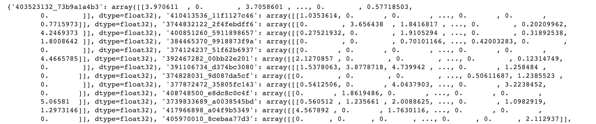
VGG16
Pretrained CNN
Input resized to 224*224
Object/Pattern Recognition
Important features as series of numbers
Feature Extraction
Notes:
Convolutional Layers: The input image is passed through a series of convolutional layers in the VGG16 model. These layers consist of filters or kernels that scan the image in small patches. Each filter detects specific visual patterns, such as edges, corners, or textures. As the image is convolved with these filters, the convolutional layers capture and highlight different visual features at various scales and levels of abstraction.
Activation Maps: After each convolutional layer, non-linear activation functions, such as ReLU (Rectified Linear Unit), are applied to introduce non-linearity into the network. These activation functions help capture more complex features by emphasizing important patterns and suppressing irrelevant information.
Pooling Layers: Periodically, pooling layers are inserted to downsample the spatial dimensions of the feature maps. This reduces the computational complexity and provides a form of translation invariance, enabling the network to focus on the most salient features while preserving their spatial relationships.
Fully Connected Layers: Once the image has traversed through several convolutional and pooling layers, the resulting feature maps are flattened into a 1-dimensional vector. This vector is then passed through fully connected layers, which act as a classifier to interpret the extracted features and make predictions based on the learned representations.
The output of VGG16's feature extraction process is a series of numbers that represents the learned visual features of the input image. Each number corresponds to a specific feature or characteristic that the model has identified, such as the presence of a certain shape, color, or texture. These feature representations can be further utilized in downstream tasks like image classification, object detection, or image captioning, where the extracted features are fed into subsequent models or networks for further processing

Slide 14
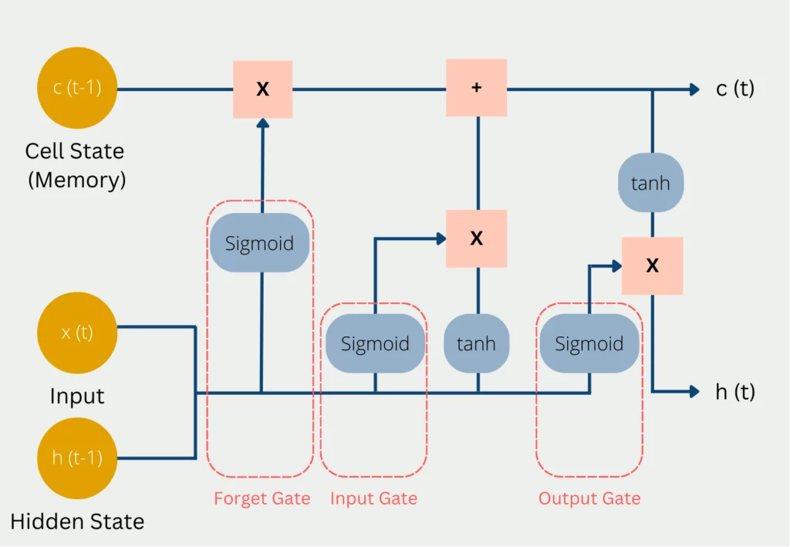

LSTM
Long short-term memory
Feature vector
Input vector to LSTM
Word prediction
based on probability
Audio Generation
Output Caption
A dog walking on the green grass
Generated Caption

Slide 15
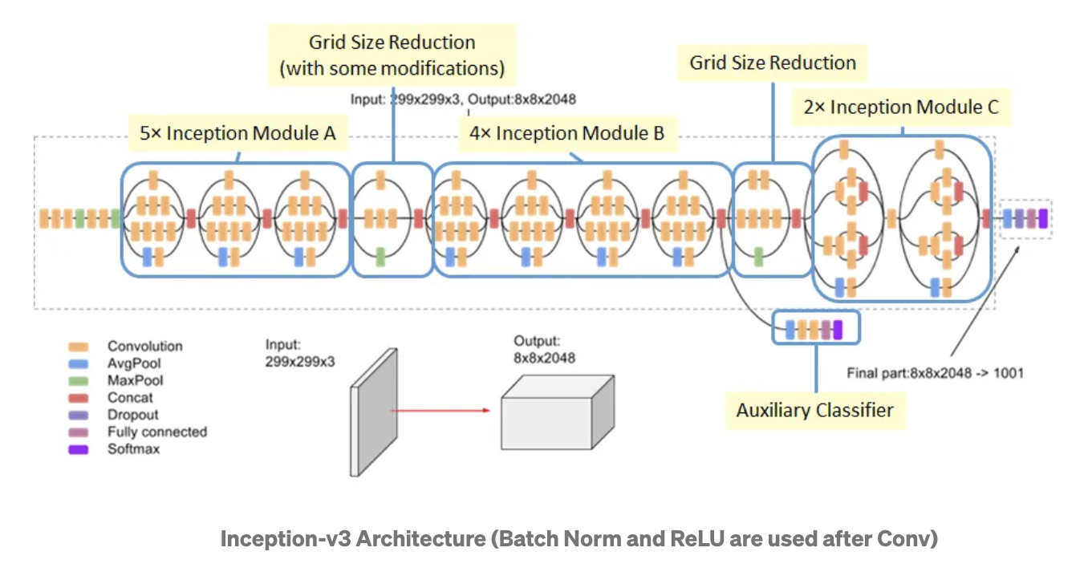
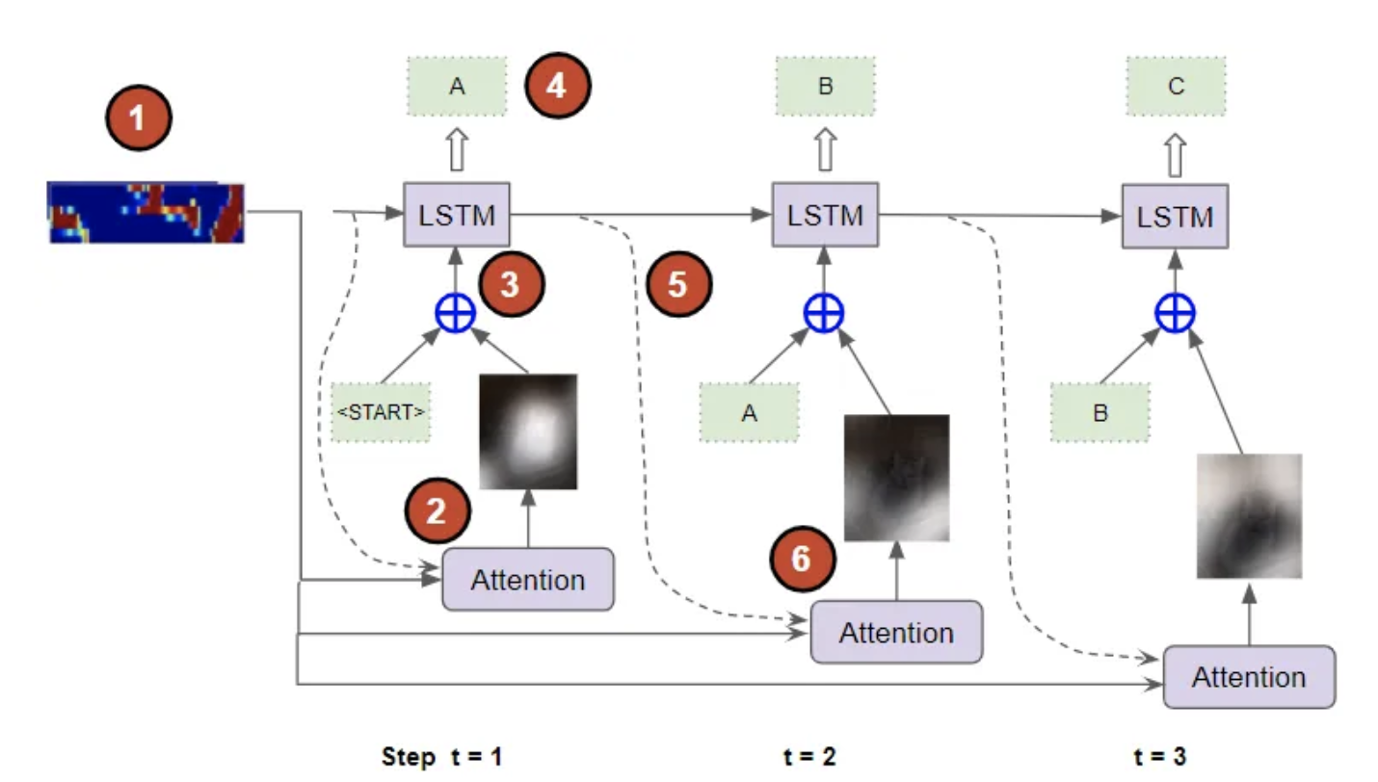
Image Captioning with Attention
Pretrained Inception V3
Input image given to
X Remove Classifier
Feature Vector
GRU
GRU
GRU
Output Caption
A brown dog walking on the green grass
Caption Generation
Caption Generation
Bahdanau Attention Network
Notes:
Image Input: We start with an input image, which could be any picture you want to generate a caption for. Let's say it's a picture of a cat.
VGG16 (Convolutional Neural Network): The image is passed through a pre-trained VGG16 model. Think of this model as a "visual brain" that can recognize and understand different visual features in the image, such as shapes, colors, and textures. The VGG16 model has been trained on a large dataset and has learned to extract meaningful information from images.
Feature Extraction: The VGG16 model extracts relevant features from the image. It identifies key visual elements like the cat's ears, eyes, and body shape. These features are represented as a set of numbers that describe the image's visual content.
LSTM (Long Short-Term Memory): The extracted features from the image are then passed into an LSTM network. You can think of the LSTM as the "language brain" that understands and generates meaningful sentences. The LSTM is trained on a large dataset of image-caption pairs, where it learns the relationship between the visual features of an image and the corresponding captions.
Caption Generation: The LSTM takes the visual features and processes them sequentially. It generates a series of words, one at a time, to form a caption. At each step, the LSTM predicts the next word based on its understanding of the visual features and the context of the previously generated words. It continues this process until it generates a complete caption.
Output: The final output is a caption that describes the image. In our example, it might be something like "A cute cat sitting on a window sill."

Slide 16
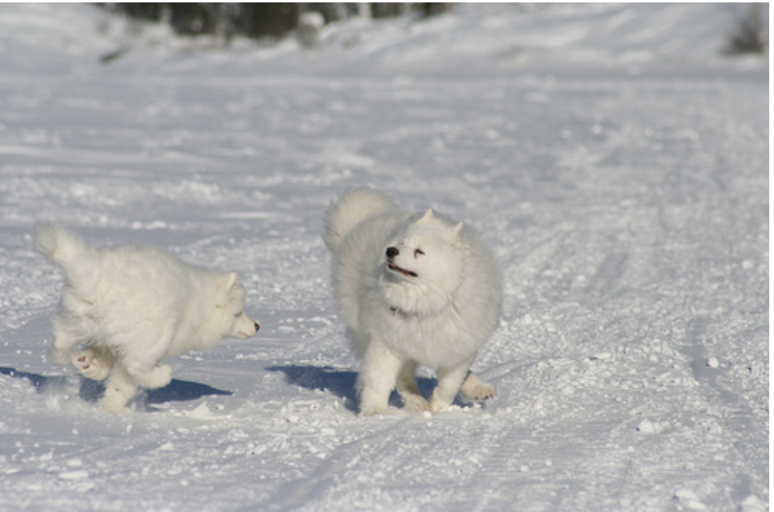
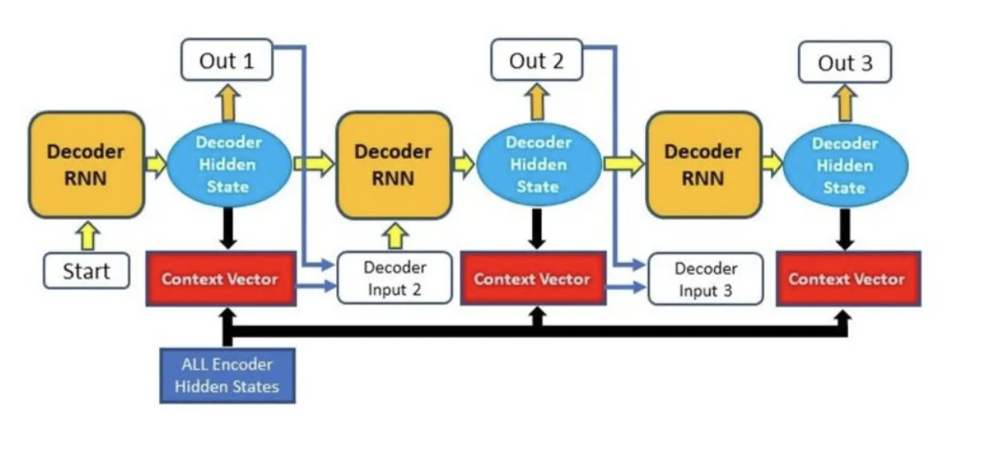
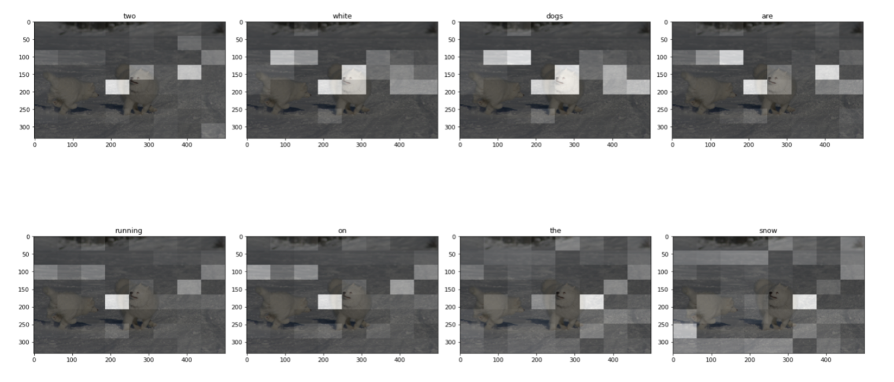
Image Captioning with Attention
Generated Sentence
Encoder CNN
Two white dogs are playing in the snow
Notes:
Encoder: It consists of a Linear layer that takes the pre-encoded image features and passes them on to the Decoder.
Sequence Decoder: this is a recurrent network built with GRUs. The captions are passed in as the input after first going through an Embedding layer.
Attention: as the Decoder generates each word of the output sequence, the Attention module helps it to focus on the most relevant part of the image for generating that word.
Sentence Generator: this module consists of a couple of Linear layers. It takes the output from the Decoder and produces a probability for each word from the vocabulary, for each position in the predicted sequence.

Slide 17
Training
#Epochs:
15
Batch Size:
64
Optimizer:
Adam
Loss:Sparse
CategoricalCrossentropy
During training, the model can make errors while predicting the next word, which would then be carried forward and affect the accuracy of subsequent predictions.
To avoid this, we use a technique called Teacher Forcing, where the correct expected word from the target caption is added to the input sequence instead of the model’s predicted word.
During inference, the model uses its own predicted output sequence as the input for the next timestep.
At each timestep, the predicted probabilities are compared with the ground truth captions to compute the loss. The loss will be used to train the network via back-propagation.
Notes:
Teacher forcing is the technique where the target word is passed as the next input to the decoder.”- Ground truth is forced to the next step. Example: Two people reading a book

Slide 18
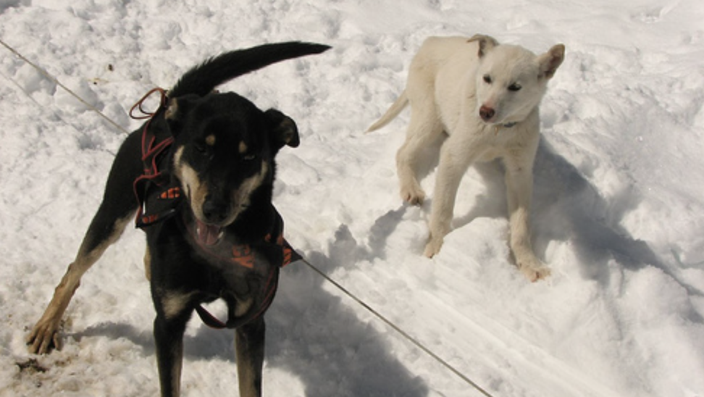
Audio Generation
Hybrid “Image2Speech”- generates text first then audio
GTTS is a Python library that uses Google Text-to-Speech API to convert text to speech
The Google Text-to-Speech API converts the text into an MP3 audio file, then downloads the MP3 file and plays it using the default audio player of the operating system.
Click the audio button

Slide 19
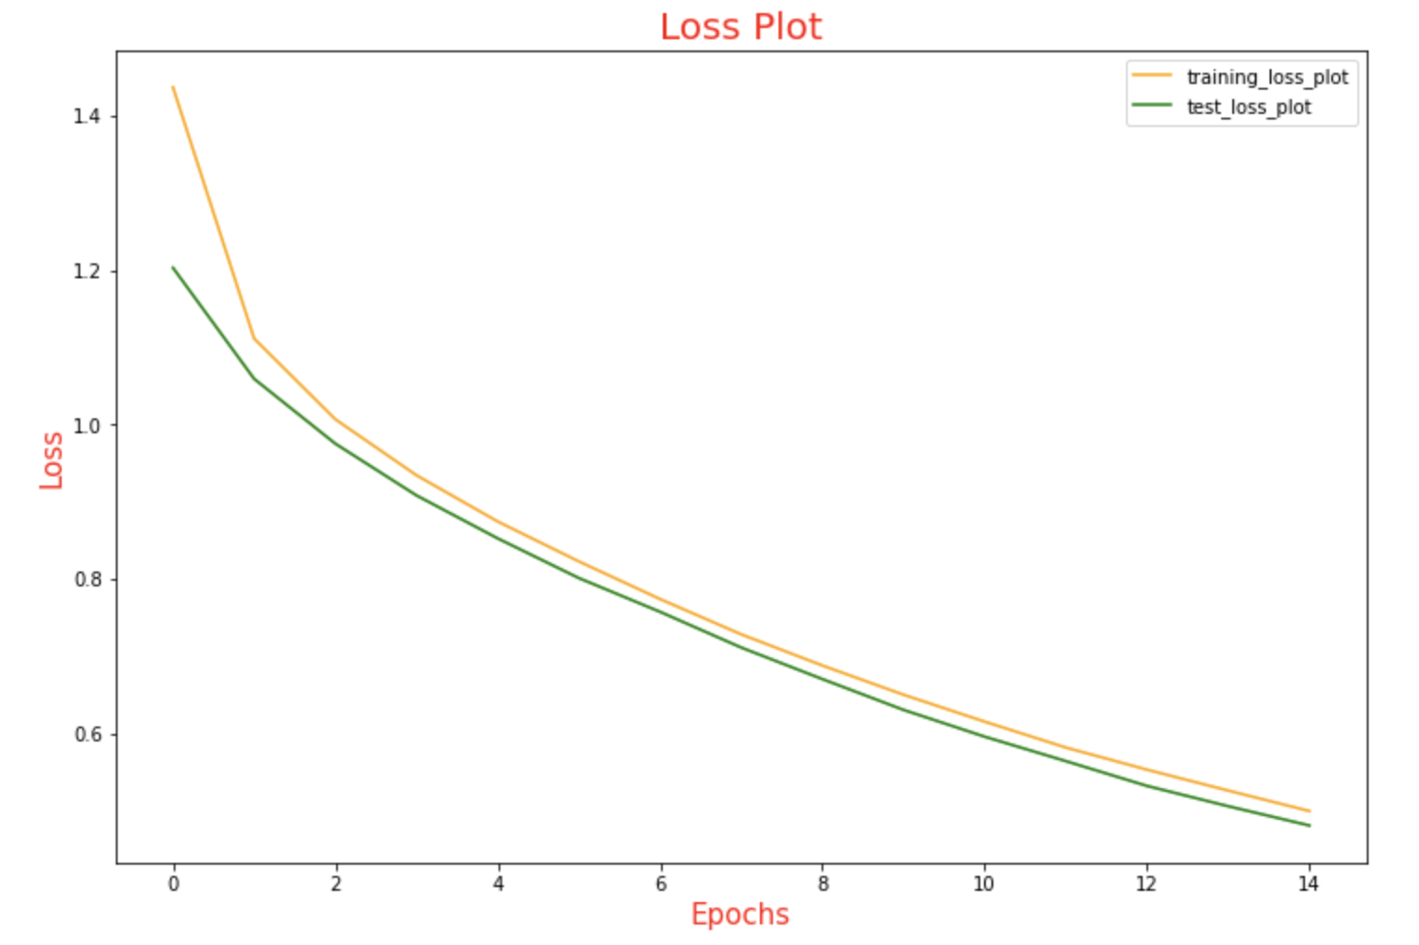
Result Comparison
A common metric for evaluating Image Caption models is the BLEU Score or the Bilingual Evaluation Understudy
It measures the number of sequential words that match between the predicted and the ground truth caption. It compares n-grams of various lengths from 1 through 4 to do this
BLEU Score for 1-gram = Correctly Predicted Words / Total predicted Words
Total Test Loss: 0.482
Model | BLEU 1 Score | BLEU 2 Score
Baseline | 0.49 | 0.27
Attention | 0.57 | 0.28

Slide 20
Conclusion
During preprocessing of Flickr8k, padding of the tokenized captions at the end of the sequence is performed to bring all captions to a fixed length.
InceptionV3, pretrained on imagenet was used for Image model.
Using Attention framework, the model is able to selectively focus on valuable parts of the input sequence hence making the model faster and increased in it's prediction accuracy.
By using Teacher Forcing technique, the model converges faster.
We used cross entropy - SparseCategoricalCrossentropy to calculate the loss.
We made use of Greedy Search to calculate the probability of words as per their occurrence in the given vocabulary list. It outputs the word with the highest probability.
Finally BLUE Score was used to evaluate our model performance and accuracy. Higher the BLUE score, better the model performance.
Notes:
Understanding teacher forcing, BLEU score

Slide 21
Future Work
Application
Architecture
Integration of our caption and audio models into an application
To improvise the architecture by implementing transformer as encoder or gpt2 for decoder
Dataset
Video Captioning
To train the models on larger and diverse datasets like Flickr 30k and MS COCO
Extending this implementation to captioning each frame in video

Slide 22

Bhakti Jayesh Raichura
25%
Data collection, Literature Review, Pre-processing, Baseline Modeling, Documentation
Team Contribution
25%
Khushee Subash Thakker
Literature Review, Baseline Modeling, Audio Generation, Documentation
Shreya Srirama
25%
Literature Review, Attention Modeling, Audio Generation, Documentation
25%
Varsha Srinivasan
Literature Review, Attention Modeling, Audio Generation, Documentation

Slide 23
References
Ayoub, S.; Gulzar, Y.; Reegu, F.A.; Turaev, S. Generating Image Captions Using Bahdanau Attention Mechanism and Transfer Learning. Symmetry 2022, 14, 2681. https://doi.org/10.3390/sym14122681
Xu, K., Ba, J., Kiros, R., Cho, K., Courville, A., Salakhudinov, R., Zemel, R., & Bengio, Y. (2015). Show, Attend and Tell: Neural Image Caption Generation with Visual Attention. In International Conference on Machine Learning (Vol. 3, pp. 2048–2057). http://proceedings.mlr.press/v37/xuc15.pdf
https://github.com/aswintechguy/Deep-Learning-Projects/blob/main/Image%20Caption%20Generator%20-%20Flickr%20Dataset/README.md
Huang, L., Wang, W., Chen, J., & Wei, X. (2019). Attention on Attention for Image Captioning. https://doi.org/10.1109/iccv.2019.00473
Dang, T., Oh, A., Na, I. S., & Kim, S. (2019). The Role of Attention Mechanism and Multi-Feature in Image Captioning. https://doi.org/10.1145/3310986.3311002
Pan, Y., Yao, T., Li, Y., & Mei, T. (2020). X-Linear Attention Networks for Image Captioning. https://doi.org/10.1109/cvpr42600.2020.01098
Cornia, M., Stefanini, M., Baraldi, L., & Cucchiara, R. (2020). Meshed-Memory Transformer for Image Captioning. https://doi.org/10.1109/cvpr42600.2020.01059
Kumar, D., Srivastava, V., Popescu, D., & Hemanth, D. J. (2022). Dual-Modal Transformer with Enhanced Inter- and Intra-Modality Interactions for Image Captioning. Applied Sciences, 12(13), 6733. https://doi.org/10.3390/app12136733

Slide 24
Thank You!

